Slide 1


SMART INDIA HACKATHON 2026
.
Problem Statement ID – SIH26051
Problem Statement Title- Software Based Model Development for Design of Area Specific Shelter for Thermal Comfort Maintenance.
Theme- Miscellaneous
PS Category- Software
Team ID-
Team Name (Registered on portal)- INFINITY

Slide 2

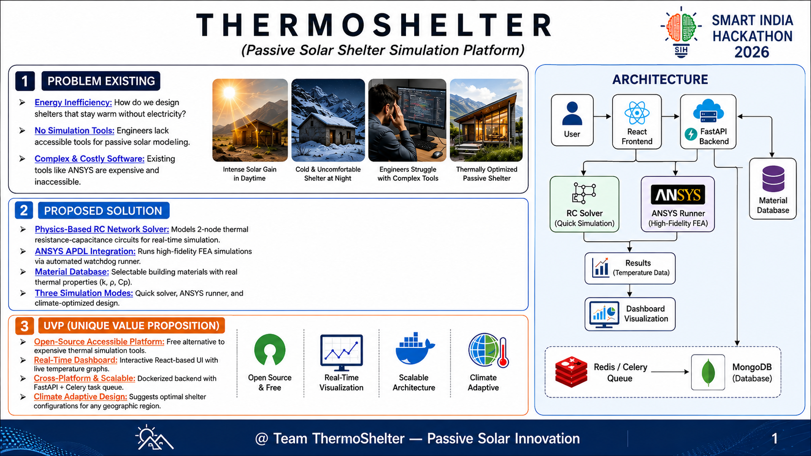
Real-Time Cold-Arid Microclimate Simulator: Diurnal solar & ambient weather integration for Leh/Ladakh.
Your Team Name
Interactive Multi-Story Envelope Builder: Ground + 1st Floor customizable walls, roofs, floors, glazing, and ACH.
1D Lumped-Parameter ODE Thermal Solver: Real-time indoor temperature curves, heat loss breakdown & ASHRAE 55 comfort.
Integrated 3D Transient FEA Structural Validator: ANSYS APDL solver mapping 3D mesh geometry.
Real-Time Housing Benchmark: Dynamic side-by-side comparison against traditional uninsulated mud shelters.
How it addresses the problem
Innovation and uniqueness of the solution
ThermoShelter — Passive Solar Simulator & Thermal Optimization Platform

Slide 3
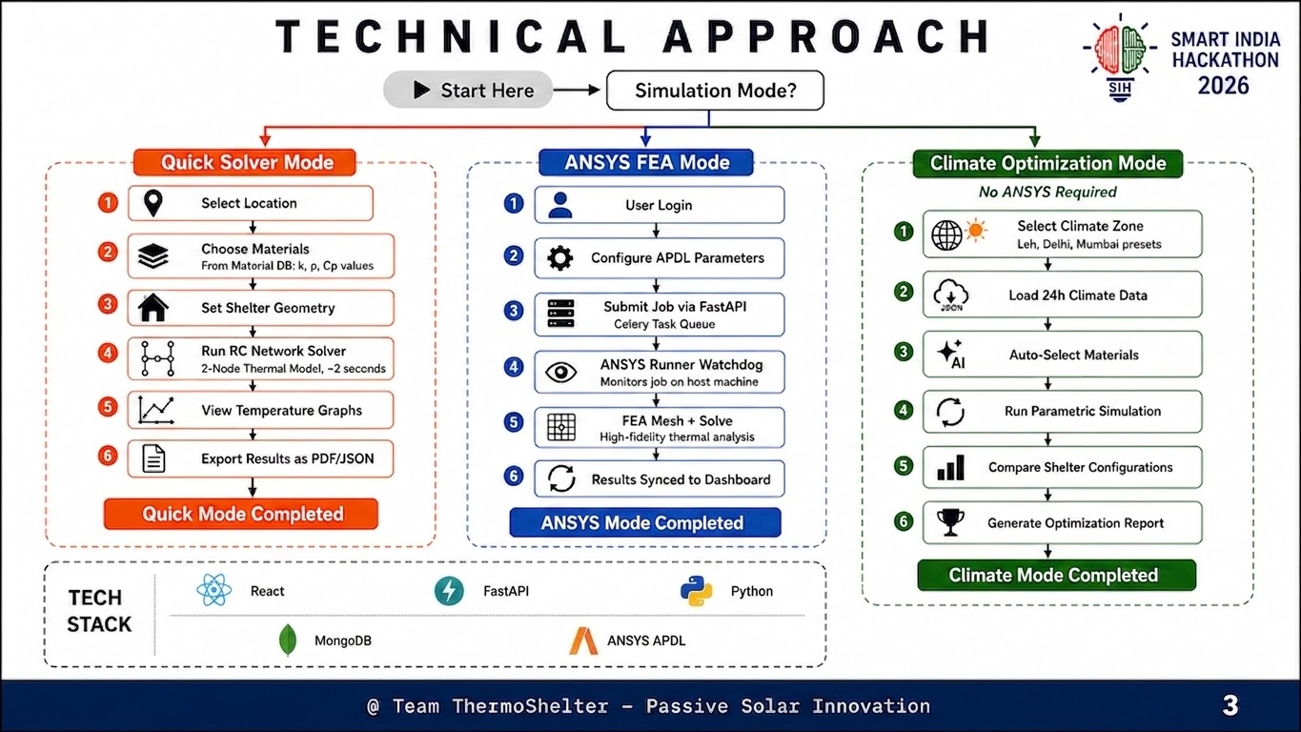
Frontend Stack: React 18, Vite, Three.js / React Three Fiber (3D Envelope Canvas), Plotly.js, Lucide Icons.
Your Team Name
Backend & Physics Engine: FastAPI (Python), SciPy (solve_ivp ODE Solver), NumPy, PyANSYS APDL Framework.
2-Node RC Thermal Network: Calculates heat balance between indoor air node (Tin) and envelope mass node (Tenv).
Technical Architecture & Physics Methodology

Slide 4
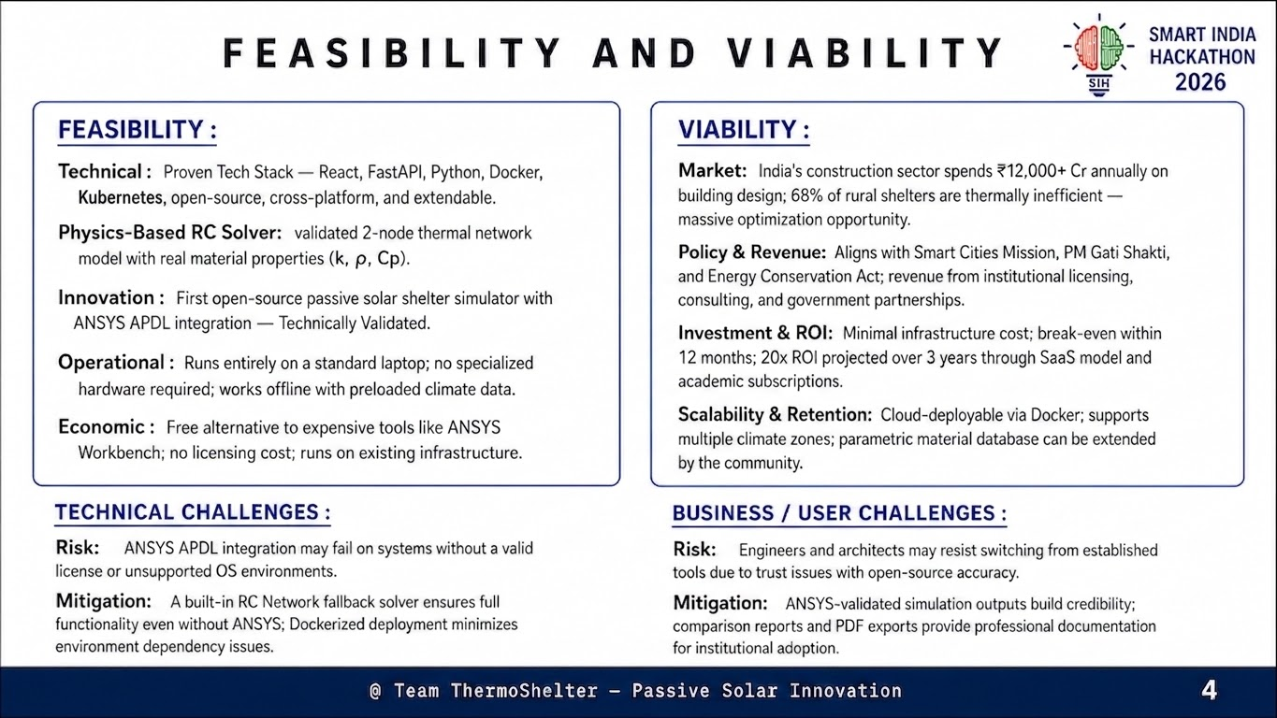
High Technical Feasibility: Pure web-based architecture running transient ODE solvers in <50ms without client setup.
Your Team Name
Operational Viability: Custom-tailored for defense forces and local communities in high-altitude cold-arid regions.
Key Challenge (3D FEA Solve Time): 3D structural mesh simulation normally requires hours and workstation licenses.
Mitigation Strategy: Fast 1D solver provides immediate real-time feedback while background runner executes ANSYS 3D FEA.
Feasibility, Risk Analysis & Mitigation

Slide 5
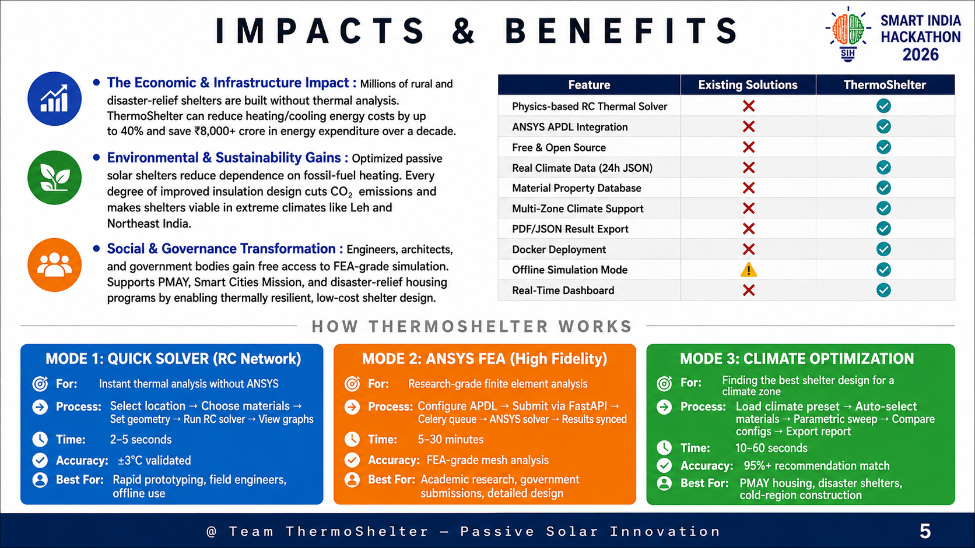
Fuel & CO2 Reduction: Saves up to 1,500 Liters of kerosene per shelter annually (~3.2 Tons CO2 prevented per building).
Your Team Name
Economic Savings: Saves over ₹1,40,000/year per shelter in heating fuel costs (up to 85% heating bill reduction).
Thermal Comfort Guarantee: Provides up to 24 hours/day of ASHRAE 55 thermal comfort (18°C–24°C) in sub-zero winter weather.
Socio-Economic & Environmental Impact

Slide 6
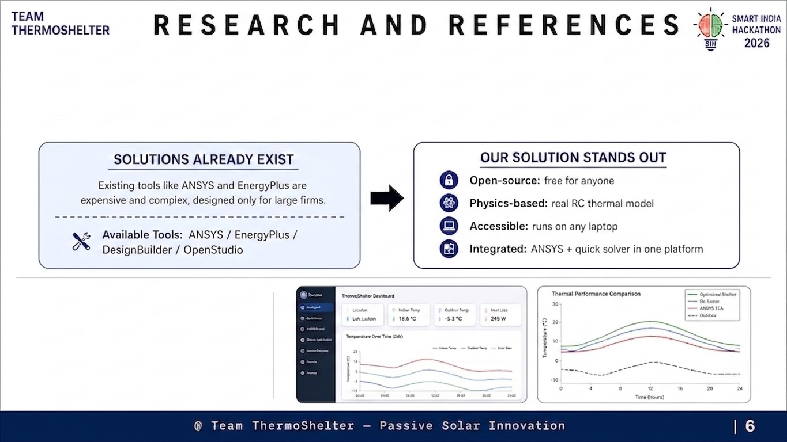
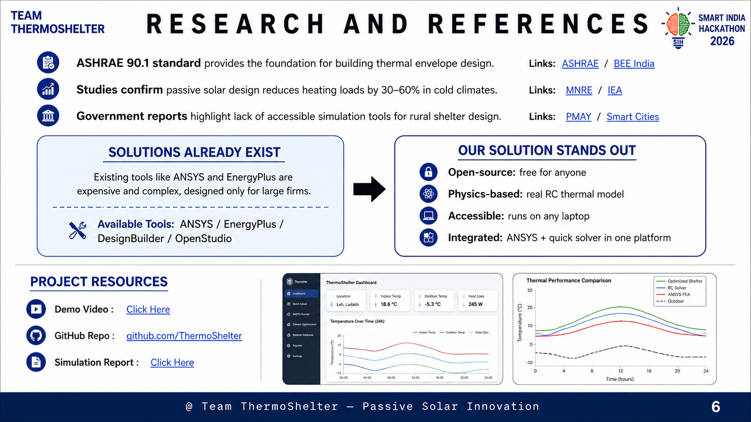

ASHRAE Standard 55: Thermal Environmental Conditions for Human Occupancy (PMV & PPD index models).
Your Team Name
IS 3792: Indian Standard Code of practice for design and construction of shelter/buildings in high-altitude cold regions.
Research Base & Engineering Standards

